Slide 1
Oracle certified Java associate
Lesson 11
Andrei Dragutan

Slide 2
Objects
Reference variable
Java stack/heap
String
static keywords

Slide 3
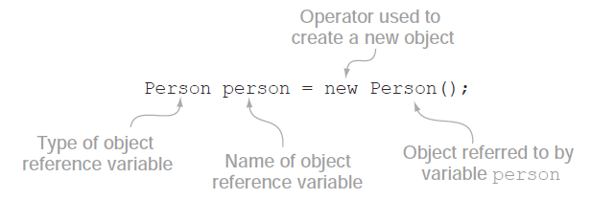

Object reference variable
Definition: reference variable is a class instance.
Note: class instance is an object of a given class type

Slide 4
Reference variable vs primitive variable
Primitive variables
can be one of any primitive type
boolean
char
int
long
short
float
Object references
Variables that are of a type described by a class. Example:
Person personObject = new Person();
Scanner scanner = new Scanner(System.in);

Slide 5
Reference variable vs primitive variable
(memory)
Stack
Special memory location that Java uses for:
primitive variables
method variables
the name of the reference variables
Note: stack memory is smaller than the Heap memory.
Heap
Special memory location used to store
objects of predefined and user defined classes
Strings

Slide 6
Reference variable: why “reference”?
The reference variable is called reference because it stores the address in the HEAP of the respective object.
The reference variable is used to address that respective object at the moment when it’s necessary.

Slide 7
Why “reference”?
In the background, person and the Person object, are stored in different memories

Slide 8
Reference variable life
public class Person {
public String name;
public String surname;
}
Person person;
person = new Person(); // New object is created in HEAP, person points to it
person = new Person(); // New object is created in HEAP
person = new Person(); // New object is created in HEAP

Slide 9
static

Slide 10
static keyword
Marks methods and attributes in a class that can be accessed without creating objects of that class.
public class Algebra {
public static void detectOddOrEven(int number) {
String result = number % 2 == 0 ? "even" : "odd";
System.out.println("Result: " + number + " is " + result);
}
}
Usage:
Algebra.detectOddOrEven(5);

Slide 11
static keyword
Marks methods and attributes in a class that can be accessed without creating objects of that class.
public class Application{
public static void main(String[] args) {
// Executable code
}
}
How does this work:
Java registers the information about the static methods when running the code. The static members of the class can be accessed without any objects of that type.

Slide 12
static attributes
Marks methods and attributes in a class that can be accessed without creating objects of that class.
public class Person {
public String name;
public String surname;
public static int counter = 0;
public Person(){
counter++;
}
}
Person jake = new Person();
Person peter = new Person();
System.out.println(peter.counter) // What will be printed?

Slide 13
static attributes
Static attributes belong to the class and are shared between all instances of that class.
As a result, static attributes should be referenced using the class name:
public class Person {
public String name;
public String surname;
public static int counter = 0;
public Person(){
counter++;
}
}
Person jake = new Person();
Person peter = new Person();
System.out.println(Person.counter) // Will print 2

Slide 14
String

Slide 15
Strings:
Intro to Strings + Creating String Objects
String Methods
String Immutability
StringBuilder/StringBuffer
String Equality/Inequality

Slide 16
What is a String?
String is a sequence of characters, but in java, string is an object that represents a sequence of characters
Example of strings:
“Java is fun”
“Jack Peterson”
“12345”

Slide 17
Creating String Objects
There are 2 ways to create String objects:
By string literal
By new keyword

Slide 18
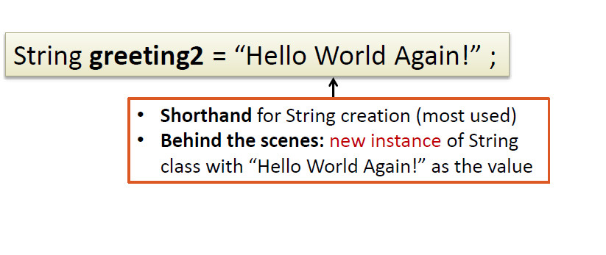
Creating objects by string literal

Slide 19

Creating objects by new Keyword
type
reference name
object
value

Slide 20
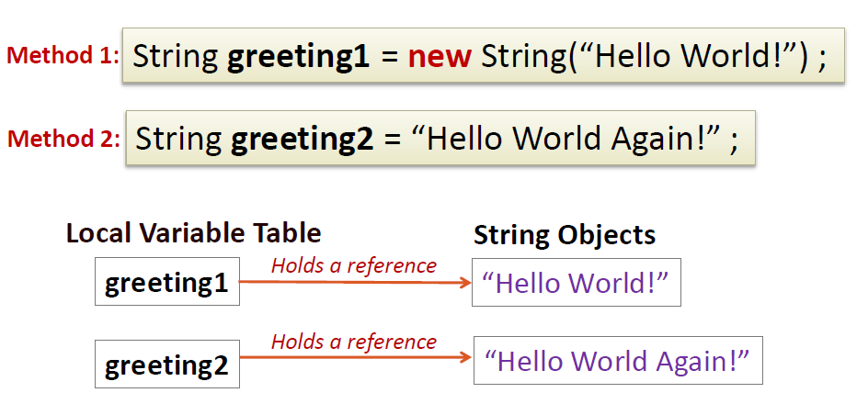
Creating String Objects

Slide 21
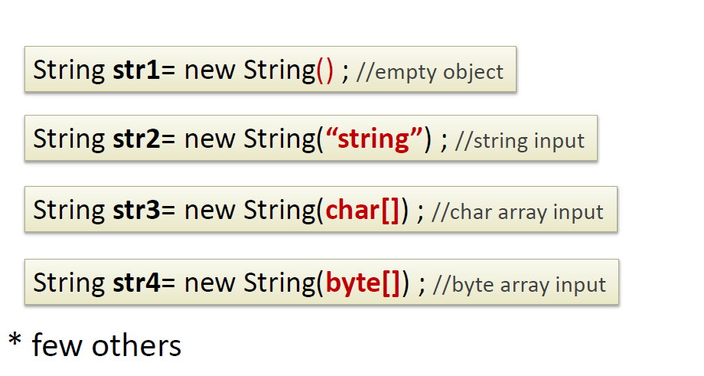
String constructor

Slide 22
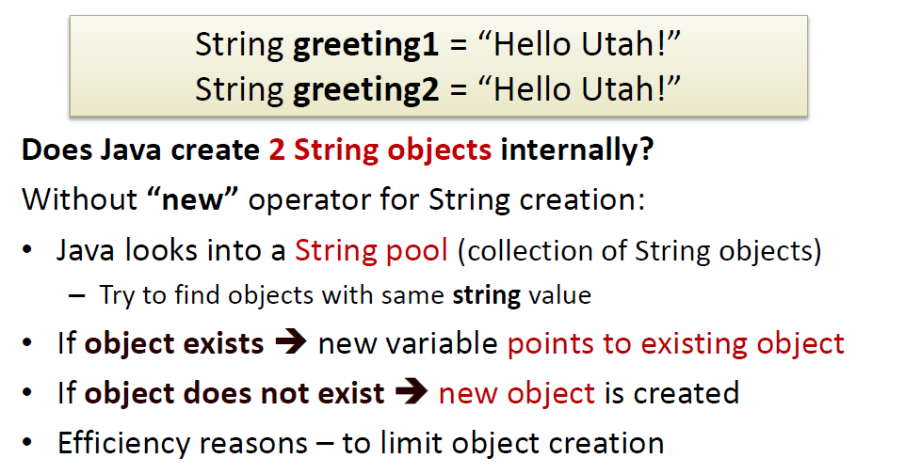
Understanding String creation with literal

Slide 23
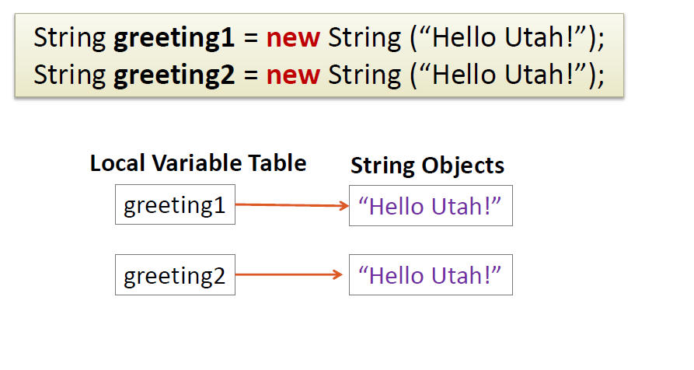
Understanding String creation with new

Slide 24
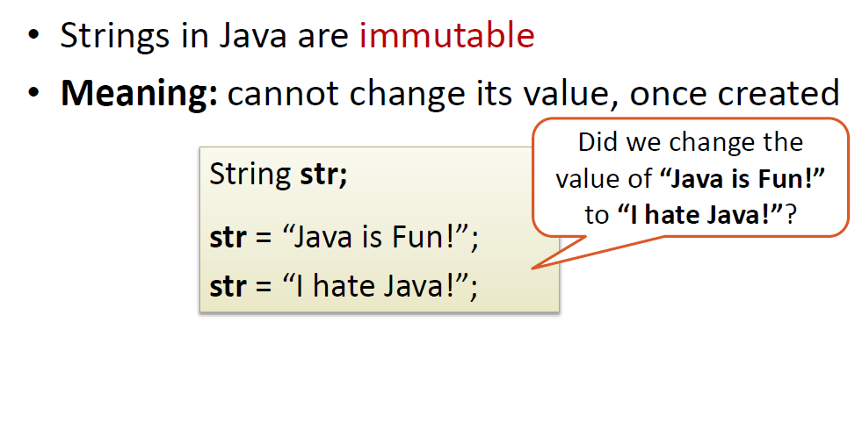
String Immutability

Slide 25
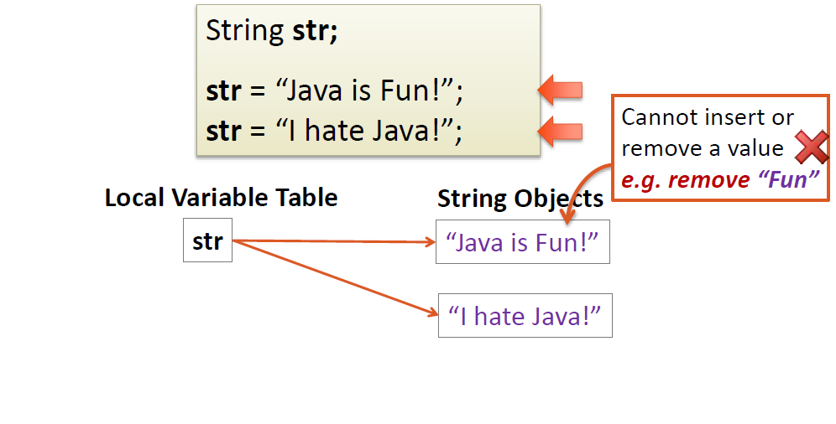
String Immutability

Slide 26
Întrebări, sugestii, propuneri

